Slide 1


JEOPARODY JEOPARODY JEOPARODY JEOPARODY JEOPARODY JEOPARODY JEOPARODY JEOPARODY JEOPARODY JEOPARODY JEOPARODY JEOPARODY JEOPARODY JEOPARODY JEOPARODY JEOPARODY JEOPARODY JEOPARODY JEOPARODY
JEOPARODY JEOPARODY JEOPARODY JEOPARODY JEOPARODY JEOPARODY JEOPARODY JEOPARODY JEOPARODY JEOPARODY JEOPARODY JEOPARODY JEOPARODY JEOPARODY JEOPARODY JEOPARODY JEOPARODY JEOPARODY JEOPARODY

Slide 2
FAQ:
Q. Is this game officially licensed by Jeopardy!?
A. No it’s not. This game is a PARODY game.
Q. How do I reset the links on the main board back to yellow?
A. Simply close the PowerPoint file, and re-open, and the links will turn back to yellow.
Q. Why aren’t the sound effects working?
A. If the sound effects aren’t working, I would suggest upgrading your PowerPoint to something newer than 2008, and using a PC instead of a Mac if possible. Also, Google slides, Keynotes, etc. are not supported.
Q. Can I get a board with less categories? Can I add a custom logo?
A. Unfortunately these changes are a little too complex for me to explain or assist you via email, but if you’d like me to do a custom job for you for a small fee, send me an email at Reid@youthdownloads.com.

Slide 3
FILE I/O | OOP | TRACING | CLASSES | POTPOURRI
B | D | A | FALSE | RELATIVE
C | INSTANCE | A | D | B
E | B | D | B | F
D | C | B | E | A
C | A | E | MULTIPLE | D

Slide 4
HERE ARE TODAY’S CATEGORIES

Slide 5

FILE I/O

Slide 6
OOP

Slide 7
TRACING

Slide 8
CLASSES

Slide 9
POTPOURRI

Slide 10
PUNNY JOKES

Slide 11
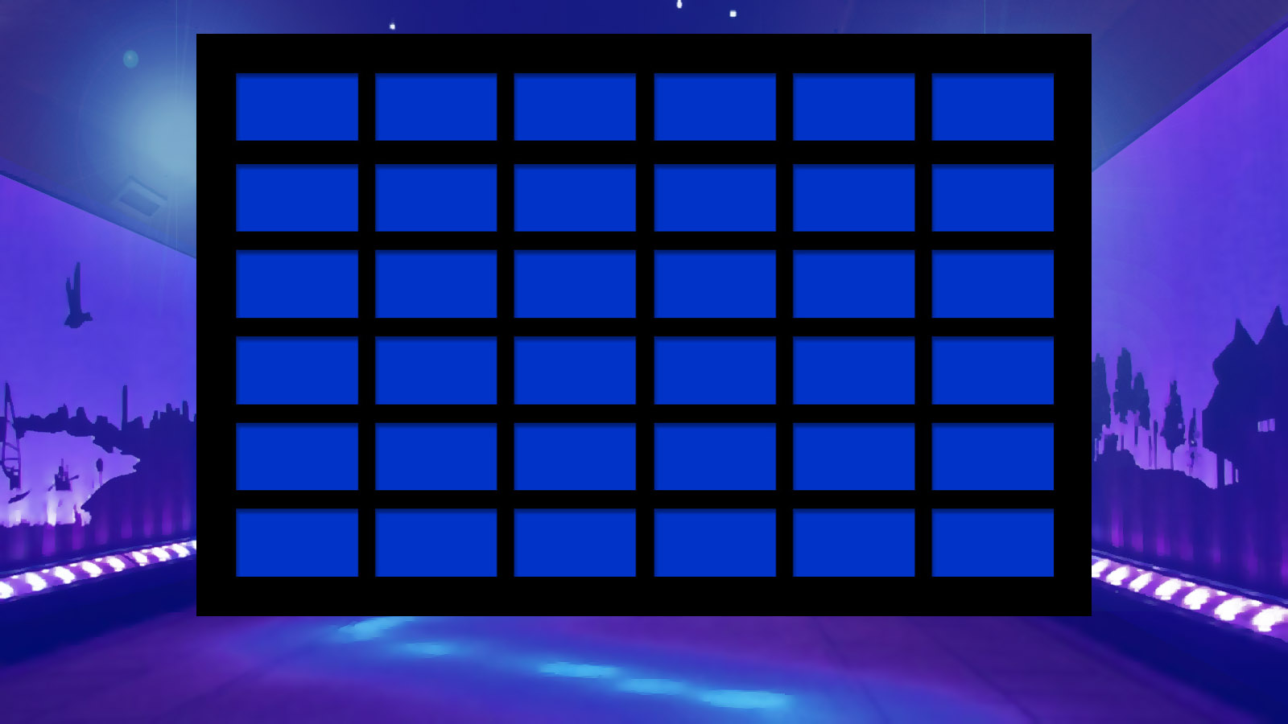
File I/O
OOP
TRACING
CLASSES
POTPOURRI
PUNNY JOKES
$100
$100
$100
$100
$100
Joke1
$200
$200
$200
$200
$200
Joke2
$300
$300
$300
$300
$300
Joke3
$400
$400
$400
$400
$400
Joke4
$500
$500
$500
$500
$500
Joke5
FINAL JEOPARODY

Slide 12
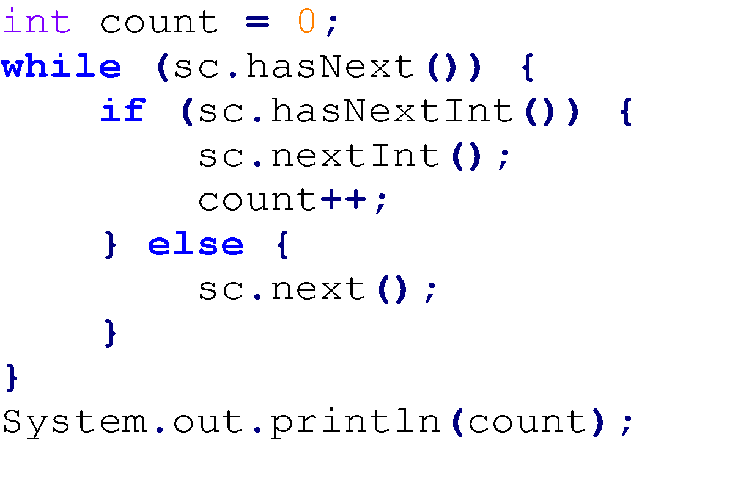
FILE I/O FOR $100
Assume that this is your input file:
10 20
hello
bye 30
Also assume that sc is a Scanner, initialized to read from the input file.
What is printed when the following code runs:
A) 2
B) 3
C) 4
D) 1
E) 0
F) None of the above

Slide 13
FILE I/O FOR $100
Assume that this is your input file:
10 20
hello
bye 30
Also assume that sc is a Scanner, initialized to read from the input file.
What is printed when the following code runs:
A) 2
B) 3
C) 4
D) 1
E) 0
F) None of the above

Slide 14
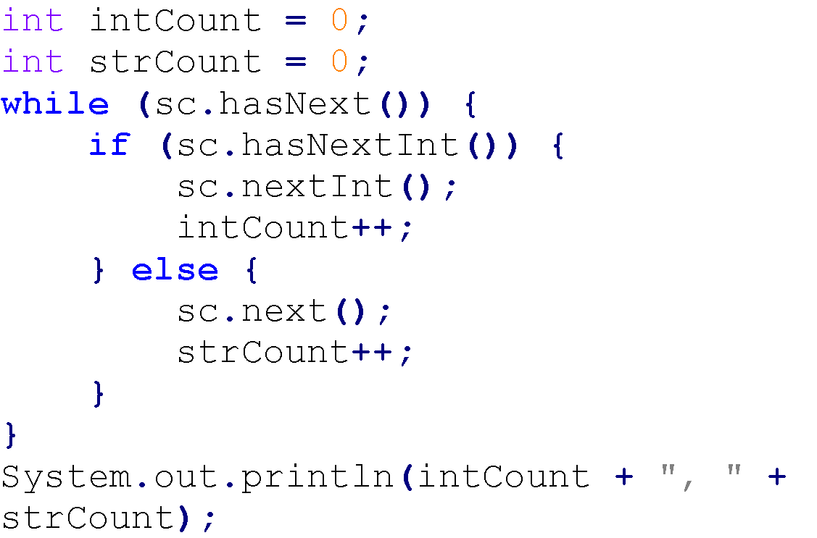
FILE I/O FOR $200
Assume that this is your input file:
10 20.5 30
Also assume that sc is a Scanner, initialized to read from the input file.
What is printed when the following code runs:
A) 3, 0
B) 1, 2
C) 2, 1
D) 0, 3
E) 3, 3
F) None of the above

Slide 15
FILE I/O FOR $200
Assume that this is your input file:
10 20.5 30
Also assume that sc is a Scanner, initialized to read from the input file.
What is printed when the following code runs:
A) 3, 0
B) 1, 2
C) 2, 1
D) 0, 3
E) 3, 3
F) None of the above

Slide 16
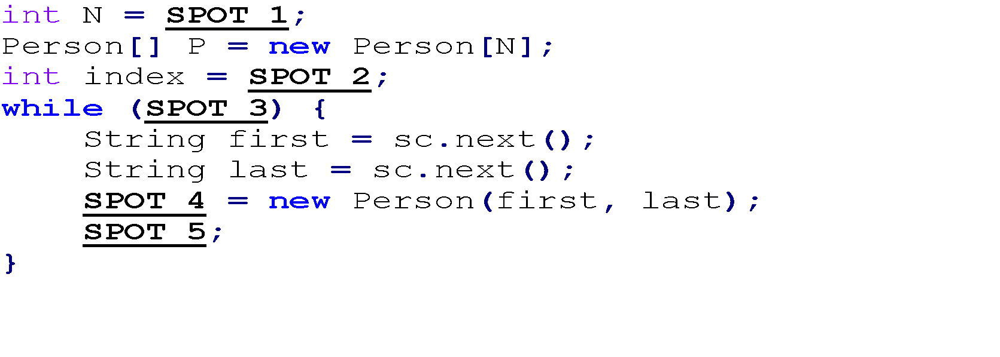
FILE I/O FOR $300
Assume that a Person class has been defined, with a 2-argument constructor. Both args are strings (the person’s first and last names). Also assume that sc is a scanner, initialized to read from an input file that contains a positive number N, followed by 2*N strings, two per line. Each line contains the first name and the last name of one person. Complete the code below to use sc to read the file and create an array containing the N people whose names are in the file. The people must be in the same order in the array as in the file.

Slide 17
FILE I/O FOR $300
Assume that a Person class has been defined, with a 2-argument constructor. Both args are strings (the person’s first and last names). Also assume that sc is a scanner, initialized to read from an input file that contains a positive number N, followed by 2*N strings, two per line. Each line contains the first name and the last name of one person. Complete the code below to use sc to read the file and create an array containing the N people whose names are in the file. The people must be in the same order in the array as in the file.
 | SPOT 1 | SPOT 2 | SPOT 3 | SPOT 4 | SPOT 5
A) | sc.nextInt() | N | index > N | P[index - 1] | index --
B) | sc.nextInt() | 1 | index < N | P[index] | index ++
C) | sc.nextInt() | N | index >= N | P[index + 1] | index --
D) | sc.nextInt() | N | index > 0 | P[index] | index --
E) | sc.nextInt() | 0 | index < N | P[index] | index ++

Slide 18
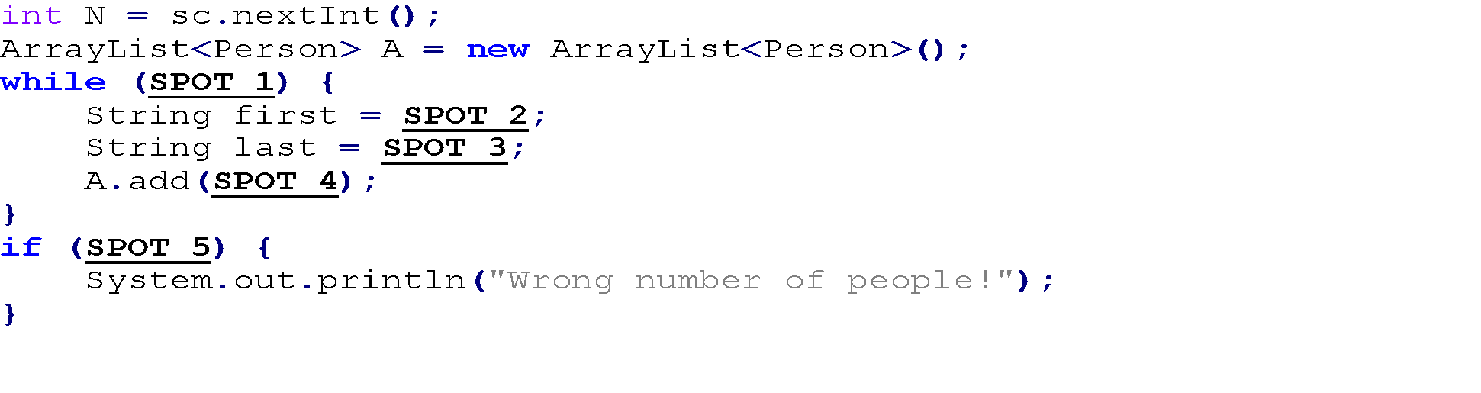
FILE I/O FOR $400
Assume that a Person class has been defined, with a 2-argument constructor. Both args are strings (the person’s first and last names). Also assume that sc is a scanner, initialized to read from an input file that contains a positive number N, followed by an even number of strings, two per line. Each line contains the first name and then the last name of one person. Complete the code below to use sc to read the file and create an ArrayList containing the people whose names are in the file. It should also print an error message if the number of people is not N.

Slide 19
FILE I/O FOR $400
Assume that a Person class has been defined, with a 2-argument constructor. Both args are strings (the person’s first and last names). Also assume that sc is a scanner, initialized to read from an input file that contains a positive number N, followed by an even number of strings, two per line. Each line contains the first name and then the last name of one person. Complete the code below to use sc to read the file and create an ArrayList containing the people whose names are in the file. It should also print an error message if the number of people is not N.
 | SPOT 1 | SPOT 2 | SPOT 3 | SPOT 4 | SPOT 5
A) | sc.hasNext() | sc.nextInt() | sc.nextInt() | new Person (last, first) | A.size() == N
B) | sc.hasNextInt() | sc.next() | sc.next() | new Person (last, first) | A.size() - 1 != N
C) | sc.hasNextInt() | sc.nextInt() | sc.nextInt() | new Person (first, last) | A.size() - 1 != N
D) | sc.hasNext() | sc.next() | sc.next() | new Person (first, last) | A.size() != N
E) | N >= 0 | N | N | new Person () | A.size() - 1 == N

Slide 20
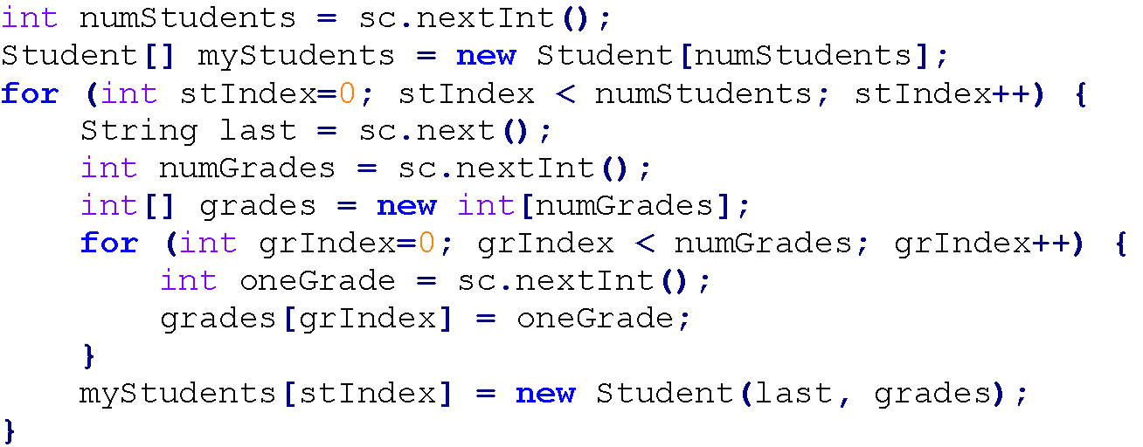
File I/O FOR $500
Assume that a Student class has been defined, with a 2-argument constructor. The first arg is a string (the student’s last name) and the second arg is an array of ints (the student’s grades).
Also assume that sc is a Scanner, initialized to read from an input file.
Based on the code below, how must the input file be formatted to input the following students and their grades:
Nick Pepper: 1, 2, 2, 4
Mary Salt: 4, 4
Chris Bay: 4, 2, 3, 4, 4, 2
A) Pepper 4 1 2 2 4
Salt 2 4 4
Bay 6 4 2 3 4 4 2
B) 3
Pepper 1 2 2 4
Salt 4 4
Bay 4 2 3 4 4 2
C) 3
Pepper 4 1 2 2 4
Salt 2 4 4
Bay 6 4 2 3 4 4 2
D) None of the
above

Slide 21
File I/O FOR $500
Assume that a Student class has been defined, with a 2-argument constructor. The first arg is a string (the student’s last name) and the second arg is an array of ints (the student’s grades).
Also assume that sc is a Scanner, initialized to read from an input file.
Based on the code below, how must the input file be formatted to input the following students and their grades:
Nick Pepper: 1, 2, 2, 4
Mary Salt: 4, 4
Chris Bay: 4, 2, 3, 4, 4, 2
A) Pepper 4 1 2 2 4
Salt 2 4 4
Bay 6 4 2 3 4 4 2
B) 3
Pepper 1 2 2 4
Salt 4 4
Bay 4 2 3 4 4 2
C) 3
Pepper 4 1 2 2 4
Salt 2 4 4
Bay 6 4 2 3 4 4 2
D) None of the
above

Slide 22
OOP FOR $100
public Class Height { private int inches; private int feet;
public Height (int feet, int inches){ this.feet = feet; this.inches = inches; } public getInches () {return this.inches;} public getFeet () {return this.feet;} }
How would a user in a different class get the inches of a height object myHeight and assign it to the int variable myInches?
A) myInches = this.inches; B) myInches = Height.inches; C) myInches = myHeight.inches; D) myInches = myHeight.getInches();

Slide 23
OOP FOR $100
public Class Height { private int inches; private int feet;
public Height (int feet, int inches){ this.feet = feet; this.inches = inches; } public getInches () {return this.inches;} public getFeet () {return this.feet;} }
How would a user in a different class get the inches of a height object myHeight and assign it to the int variable myInches?
A) myInches = this.inches; B) myInches = Height.inches; C) myInches = myHeight.inches; D) myInches = myHeight.getInches();

Slide 24
OOP FOR $200
Team
Type = basketball
Name = Bucks
Location = Milwaukee
Name the classes defined by this diagram.
PLAYER
Name = Giannis
Height = 6.11
Number = 34
PLAYER
Name = Khris
Height = 6.8
Number = 22

Slide 25
OOP FOR $200
Team
Type = basketball
Name = Bucks
Location = Milwaukee
Team and PLAYER classes
PLAYER
Name = Giannis
Height = 6.11
Number = 34
PLAYER
Name = Khris
Height = 6.8
Number = 22

Slide 26
OOP FOR $300
public Class Height {
private int inches;
private int feet;
public Height (int feet, int inches){ this.feet = feet; this.inches = inches; } public int convertHeight () { return doMath(); }
public static int doMath (){ return feet*12 + inches; }
}
Which of the following statements about the class above is true?
A) We'd reach the singularity
B) A compile time error would occur since a static method uses non-static variables
C) A compile time error would occur because a static method exists in a non-static class
D) If Height.doMath() were called from a different class, the height in inches would be returned

Slide 27
OOP FOR $300
public Class Height {
private int inches;
private int feet;
public Height (int feet, int inches){ this.feet = feet; this.inches = inches; } public int convertHeight () { return doMath(); }
public static int doMath (){ return feet*12 + inches; }
}
Which of the following statements about the class above is true?
A) We'd reach the singularity
B) A compile time error would occur since a static method uses non-static variables
C) A compile time error would occur because a static method exists in a non-static class
D) If Height.doMath() were called from a different class, the height in inches would be returned

Slide 28
OOP FOR $400
Which of the following is an example of overloading?
A) void fun() {
int a=10;
System.out.println(a);
}
public static void main(String args[]) {
int a;
fun();
}
B) class student {
private int a;
public int b;
}
C) public int add(int a){
return (a+a);
}
public int add(int a, int b){
return(a+b);
}
D) enum fruit { APPLE, ORANGE, GRAPE, BANANA }

Slide 29
OOP FOR $400
Which of the following is an example of overloading?
A) void fun() {
int a=10;
System.out.println(a);
}
public static void main(String args[]) {
int a;
fun();
}
B) class student {
private int a;
public int b;
}
C) public int add(int a){
return (a+a);
}
public int add(int a, int b){
return(a+b);
}
D) enum fruit { APPLE, ORANGE, GRAPE, BANANA }

Slide 30
OOP FOR $500
Which of the following is true about interfaces in java.
An interface can contain following type of members. ....public, static, final fields (i.e., constants) ....default and static methods with bodies
An instance of interface can be created.
A class can implement multiple interfaces.
Many classes can implement the same interface.
1, 3, and 4
1, 2, and 4
2, 3, and 4
1, 2, 3, and 4

Slide 31
OOP FOR $500
Which of the following is true about interfaces in java.
An interface can contain following type of members. ....public, static, final fields (i.e., constants) ....default and static methods with bodies
An instance of interface can be created.
A class can implement multiple interfaces.
Many classes can implement the same interface.
1, 3, and 4
1, 2, and 4
2, 3, and 4
1, 2, 3, and 4

Slide 32
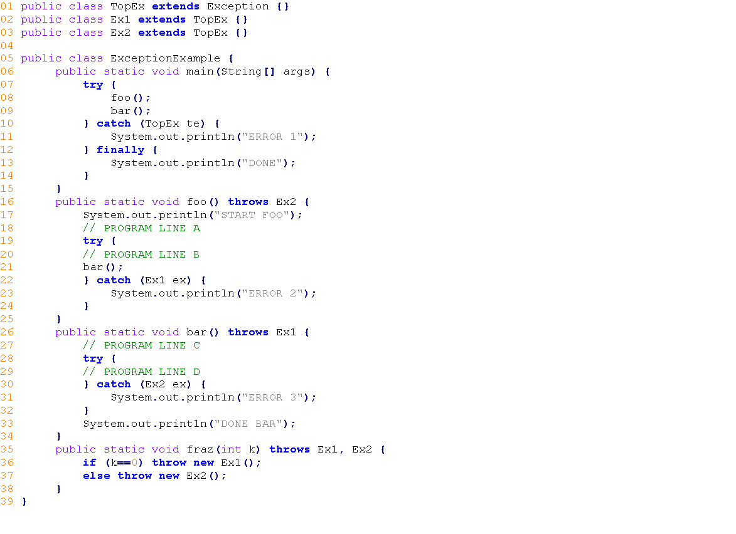
TRACING FOR $100
What is printed when none of the “PROGRAM LINE” comments is replaced with code?
A)
START FOO
DONE BAR
DONE BAR
DONE
B)
START FOO
DONE BAR
DONE
C)
START FOO
DONE BAR
DONE BAR
D)
START FOO
DONE BAR
E)
START FOO
ERROR 3
ERROR 3
DONE
F) None of the above

Slide 33
TRACING FOR $100
What is printed when none of the “PROGRAM LINE” comments is replaced with code?
A)
START FOO
DONE BAR
DONE BAR
DONE
B)
START FOO
DONE BAR
DONE
C)
START FOO
DONE BAR
DONE BAR
D)
START FOO
DONE BAR
E)
START FOO
ERROR 3
ERROR 3
DONE
F) None of the above

Slide 34
TRACING FOR $200
public static boolean larger(int x, int y) {
if (x > y) return true;
if (y > x) return false;
}
Which of the following statements about method larger is correct?
A. The code will not compile because it does not always return a value.
B. The code will not compile because it has int parameters but returns a boolean.
C. The code will compile and always returns the correct value.
D. The code will compile but always returns the wrong value.
E. The code will compile but sometimes returns the wrong value.

Slide 35
TRACING FOR $200
public static boolean larger(int x, int y) {
if (x > y) return true;
if (y > x) return false;
}
Which of the following statements about method larger is correct?
A. The code will not compile because it does not always return a value.
B. The code will not compile because it has int parameters but returns a boolean.
C. The code will compile and always returns the correct value.
D. The code will compile but always returns the wrong value.
E. The code will compile but sometimes returns the wrong value.

Slide 36
TRACING FOR $300
What is printed when PROGRAM LINE B is replaced with: throw new Ex1();
A) START FOO
ERROR 2
DONE BAR
DONE BAR
DONE
B) START FOO
ERROR 1
DONE
C) START FOO
D) START FOO
ERROR 2
DONE BAR
DONE
E) START FOO
ERROR 3
ERROR 3
DONE
F) None of the above

Slide 37
TRACING FOR $300
What is printed when PROGRAM LINE B is replaced with: throw new Ex1();
A) START FOO
ERROR 2
DONE BAR
DONE BAR
DONE
B) START FOO
ERROR 1
DONE
C) START FOO
D) START FOO
ERROR 2
DONE BAR
DONE
E) START FOO
ERROR 3
ERROR 3
DONE
F) None of the above

Slide 38
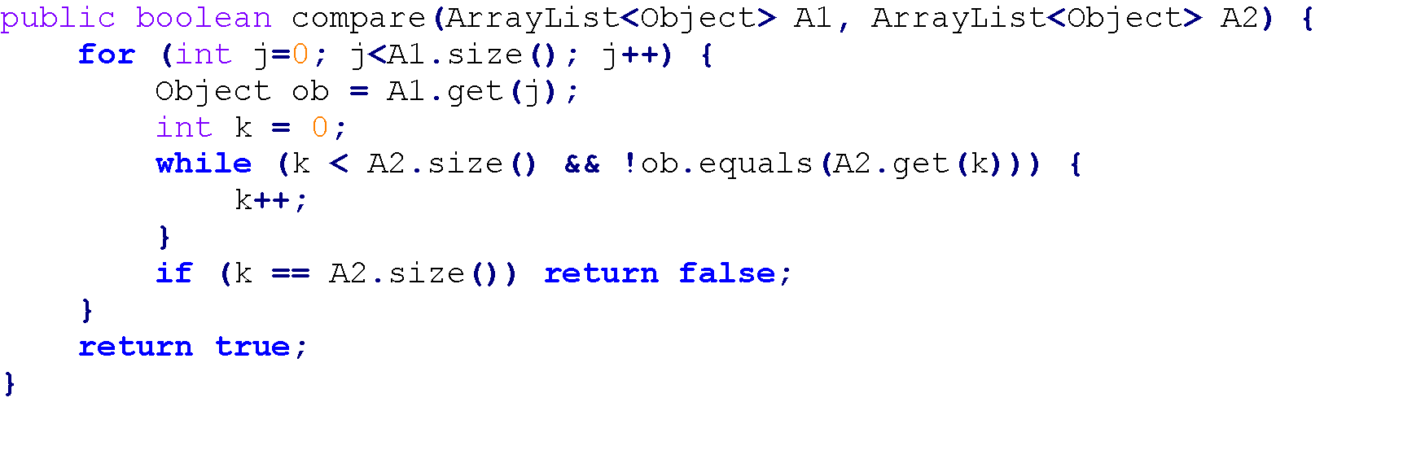
TRACING FOR $400
When does the following method return true?
A) When every object in A2 is also in A1.
B) When every object in A1 is also in A2.
C) Always
D) Never
E) When CS200 is taught in Python

Slide 39
TRACING FOR $400
When does the following method return true?
A) When every object in A2 is also in A1.
B) When every object in A1 is also in A2.
C) Always
D) Never
E) When CS200 is taught in Python

Slide 40
TRACING FOR $500
What is printed when PROGRAM LINE D is replaced with: throw new Ex1();
A) START FOO
ERROR 2
ERROR 1
B) START FOO
ERROR 3
DONE BAR
ERROR 3
DONE BAR
DONE
C) START FOO
ERROR 1
DONE
D) START FOO
ERROR 1
ERROR 1
E) START FOO
ERROR 2
ERROR 1
DONE
F) None of the above

Slide 41
TRACING FOR $500
What is printed when PROGRAM LINE D is replaced with: throw new Ex1();
A) START FOO
ERROR 2
ERROR 1
B) START FOO
ERROR 3
DONE BAR
ERROR 3
DONE BAR
DONE
C) START FOO
ERROR 1
DONE
D) START FOO
ERROR 1
ERROR 1
E) START FOO
ERROR 2
ERROR 1
DONE
F) None of the above

Slide 42
CLASSES FOR $100
True or False: In the term Math.PI, Math is the name of an instance of the java.lang.Math class.

Slide 43
CLASSES FOR $100
True or False: In the term Math.PI, Math is the name of an instance of the java.lang.Math class.

Slide 44
CLASSES FOR $200
Do other classes need a main method?

Slide 45
CLASSES FOR $200
No, other classes do not need a main method.

Slide 46
CLASSES FOR $300
Public class User{
private static int users = 0;
private String name;
private int age;
public User(String name, int age){
this.name = name;
this.age = age;
users++;
}
public static int getUsers(){
return users;
}
}
What would the following code do (assuming that user1 and user2 are created previously and are the only instances of the User class):
System.out.print(user1.getUsers() + ", ");
System.out.println(user2.getUsers());
A. 1, 2
B. 1, 1
C. 2, 1
D. 2, 2
E. The code will not execute

Slide 47
CLASSES FOR $300
Public class User{
private static int users = 0;
private String name;
private int age;
public User(String name, int age){
this.name = name;
this.age = age;
users++;
}
public static int getUsers(){
return users;
}
}
What would the following code do (assuming that user1 and user2 are created previously and are the only instances of the User class):
System.out.print(user1.getUsers() + ", ");
System.out.println(user2.getUsers());
A. 1, 2
B. 1, 1
C. 2, 1
D. 2, 2
E. The code will not execute

Slide 48
CLASSES FOR $400
What is the constructor for this class?
public class Fruit {
private boolean yummy;
public final String color;
....
}
A) public Fruit( String color, boolean yummy ) {
yummy = this.yummy;
color = color;
}
B) public Fruit( String color, boolean yummy ) {
this.yummy = yummy;
this.color = color;
}
C. public Fruit( String color, boolean amYummy ) {
amYummy = this.amYummy;
color = this.color;
}
D) public void Fruit( String color, boolean yummy ) {
System.out.println("Enter color :");
java.util.Scanner stdin = new java.util.Scanner( System.in );
yummy = true;
color = stdin.nextLine();
}
E) public Fruit Fruit(String color, boolean yummy ) {
yummy = this(yummy);
color = this(color);
return this;
}

Slide 49
CLASSES FOR $400
What is the constructor for this class?
public class Fruit {
private boolean yummy;
public final String color;
....
}
A) public Fruit( String color, boolean yummy ) {
yummy = this.yummy;
color = color;
}
B) public Fruit( String color, boolean yummy ) {
this.yummy = yummy;
this.color = color;
}
C. public Fruit( String color, boolean amYummy ) {
amYummy = this.amYummy;
color = this.color;
}
D) public void Fruit( String color, boolean yummy ) {
System.out.println("Enter color :");
java.util.Scanner stdin = new java.util.Scanner( System.in );
yummy = true;
color = stdin.nextLine();
}
E) public Fruit Fruit(String color, boolean yummy ) {
yummy = this(yummy);
color = this(color);
return this;
}

Slide 50
CLASSES FOR $500
A) private Student (){
age = 18;
grade = ‘A’;
}
private Student (int age, char grade){
this.age = age;
this.grade = grade;
}
B) public static new (){
grade = ‘A’;
}
C) public Student (int age, char grade){
this.age = age;
this.grade = grade;
}
D) private Student (){
age = 0;
grade = ‘A’;
}
E) public Student (){
age = 18;
grade = ‘A’;
}
public Student (int age, char grade){
this.age = age;
this.grade = grade;
}
What should the constructor(s) for the following Student Class look like?
public class Classroom{
public static void main(String [] args){
Student john = new Student();
Student kim = new Student(20, ‘A’);
}
public class Student{
private int age;
private char grade;
*Constructor*
}

Slide 51
CLASSES FOR $500
D) private Student (){
age = 0;
grade = ‘A’;
}
E) public Student (){
age = 18;
grade = ‘A’;
}
public Student (int age, char grade){
this.age = age;
this.grade = grade;
}
D) private Student (){
age = 0;
grade = ‘A’;
}
E) public Student (){
age = 18;
grade = ‘A’;
}
public Student (int age, char grade){
this.age = age;
this.grade = grade;
}
D) private Student (){
age = 0;
grade = ‘A’;
}
E) public Student (){
age = 18;
grade = ‘A’;
}
public Student (int age, char grade){
this.age = age;
this.grade = grade;
}

Slide 52
POTPOURRI FOR $100
Which of the following are runtime exceptions:
I. NullPointerException
II. IndexOutOfBoundsException
III. IO Exception
a. I only
b. I and II
c. I II and III
d. II and III
e. none of the above

Slide 53
POTPOURRI FOR $100
Which of the following are runtime exceptions:
I. NullPointerException
II. IndexOutOfBoundsException
III. IO Exception
a. I only
b. I and II
c. I, II, and III
d. II and III
e. none of the above

Slide 54
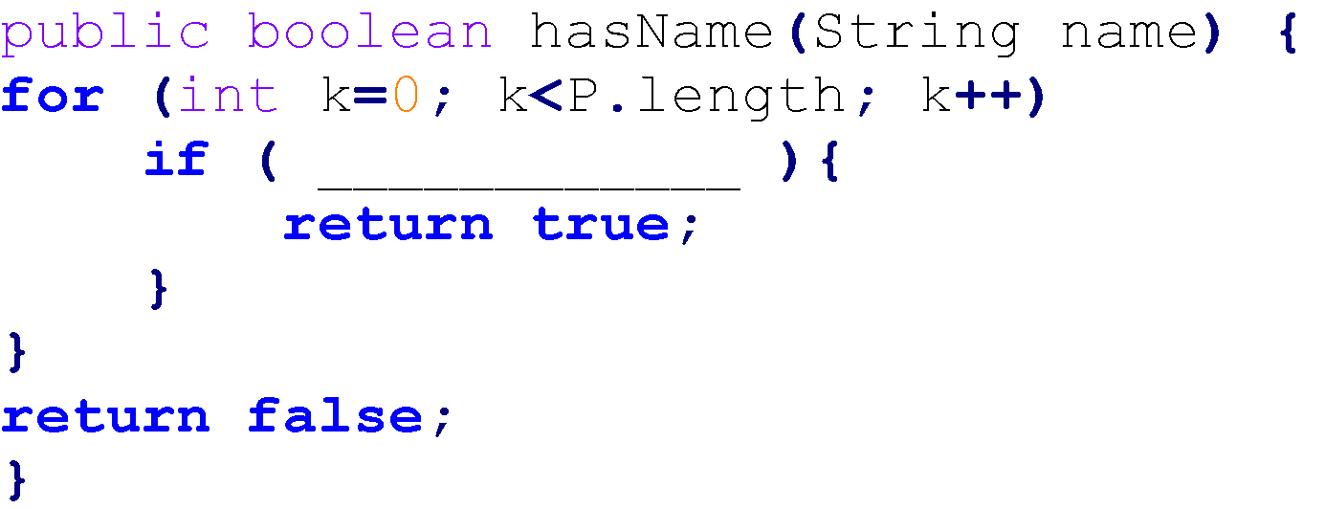
POTPOURRI FOR $200
Assume that a Person class has been defined with a public getName() method that returns a String.
Also assume that a class has a field P declared as follows:
Person[] P;
and that P has been filled with people.
What code could be used to fill in the blank below so that the method returns true iff there is a person in P with the given name?
A) P[k].getName() == name
B) P[k].getName().equals(name)
C) ! P[k].getName().equals(name)
D) P[k].getName() != name
E) None of the above

Slide 55
POTPOURRI FOR $200
Assume that a Person class has been defined with a public getName() method that returns a String.
Also assume that a class has a field P declared as follows:
Person[] P;
and that P has been filled with people.
What code could be used to fill in the blank below so that the method returns true iff there is a person in P with the given name?
A) P[k].getName() == name
B) P[k].getName().equals(name)
C) ! P[k].getName().equals(name)
D) P[k].getName() != name
E) None of the above

Slide 56
POTPOURRI FOR $300
Which “PROGRAM LINE” comments can be replaced by:
throw new TopEx();
without causing a compile-time error?
A) A, B only
B) C, D only
C) D only
D) B only
E) A, B, C, D
F) None of the above combinations

Slide 57
POTPOURRI FOR $300
Which “PROGRAM LINE” comments can be replaced by:
throw new TopEx();
without causing a compile-time error?
A) A, B only
B) C, D only
C) D only
D) B only
E) A, B, C, D
F) None of the above combinations

Slide 58
POTPOURRI FOR $400
String[] arr1 = new String[3];
String one = “red”;
String two = “blue”;
String three = “yellow”;
arr1[0] = one;
arr1[1] = two;
arr1[2] = three;
String[] arr2 = {one, “blue”, “yellow”};
if(…) {
System.out.println(“They are the same!”);
}
Which of the following statements would make this code print?
I. arr1[0].equals(arr2[0])
II. arr1[0] == arr2[0]
III. arr1[2] == arr2[2]
A. I, II and III
B. I and III only
C. I and II only
D. II and III only
E. None of the above

Slide 59
POTPOURRI FOR $400
String[] arr1 = new String[3];
String one = “red”;
String two = “blue”;
String three = “yellow”;
arr1[0] = one;
arr1[1] = two;
arr1[2] = three;
String[] arr2 = {one, “blue”, “yellow”};
if(…) {
System.out.println(“They are the same!”);
}
Which of the following statements would make this code print?
I. arr1[0].equals(arr2[0])
II. arr1[0] == arr2[0]
III. arr1[2] == arr2[2]
A. I, II and III
B. I and III only
C. I and II only
D. II and III only
E. None of the above

Slide 60
POTPOURRI FOR $500
Which “PROGRAM LINE” comments can be replaced by:
fraz(10);
without causing a compile-time error?
A) A, B only
B) A, B, D only
C) A, C only
D) B, D only
E) A, B, C, D
F) None of the above combinations

Slide 61
POTPOURRI FOR $500
Which “PROGRAM LINE” comments can be replaced by:
fraz(10);
without causing a compile-time error?
A) A, B only
B) A, B, D only
C) A, C only
D) B, D only
E) A, B, C, D
F) None of the above combinations

Slide 62
PUNNY JOKE #1
Why can't cats work on the computer?

Slide 63
PUNNY JOKE #1
Why can't cats work on the computer?
---
They get too distracted chasing the mouse around.

Slide 64
PUNNY JOKE #2
Which way did the programmer go?

Slide 65
PUNNY JOKE #2
Which way did the programmer go?
---
They went DATA way!

Slide 66
PUNNY JOKE #3
What does a proud computer call their child?

Slide 67
PUNNY JOKE #3
What does a proud computer call their child?
---
A microchip off the old block.

Slide 68
PUNNY JOKE #4
What did the student tell the teacher about a missing programming assignment?

Slide 69
PUNNY JOKE #4
What did the student tell the teacher about a missing programming assignment?
---
The dog ate their homework
looking for a byte to eat.

Slide 70
PUNNY JOKE #5
I don't like computer science jokes...

Slide 71
PUNNY JOKE #5
I don't like computer science jokes...
---
Not one bit.

Slide 72


Slide 73
FINAL JeoPARODY
Correct the mistakes in the Water Jug Java Class.
class WaterJug{
private static final waterBrand = “Dasani”;
private int waterLeft;
private boolean empty;
private int sizeOfJug;
//constructor
public void MakeWaterJug(int sizeOfJug){
sizeOfJug = sizeOfJug;
empty = false;
waterLeft = sizeOfJug;
}
public void pourOutWater(int amtToPour){
waterLeft - amtToPour;
if(waterLeft <= 0 ){
empty = true;
}
return empty;
}
private int getWaterLeft(){
return waterLeft;
}
public static boolean isEmpty(){
return empty;
}
}
GO TO
PROMPT
(RESPONSE)
Start Timer

Slide 74
FINAL JeoPARODY
Correct the mistakes in the Water Jug Java Class.
class WaterJug{
private static final String WATER_BRAND = “Dasani”;
private int waterLeft;
private boolean empty;
private int sizeOfJug;
//constructor
public void WaterJug(int sizeOfJug){
this.sizeOfJug = sizeOfJug;
empty = false;
waterLeft = sizeOfJug;
}
public void pourOutWater(int amtToPour){
waterLeft -= amtToPour;
if(waterLeft <= 0 ){
empty = true;
}
return empty;
}
public int getWaterLeft(){
return waterLeft;
}
public static boolean isEmpty(){
return empty;
}
}

